Slide 1
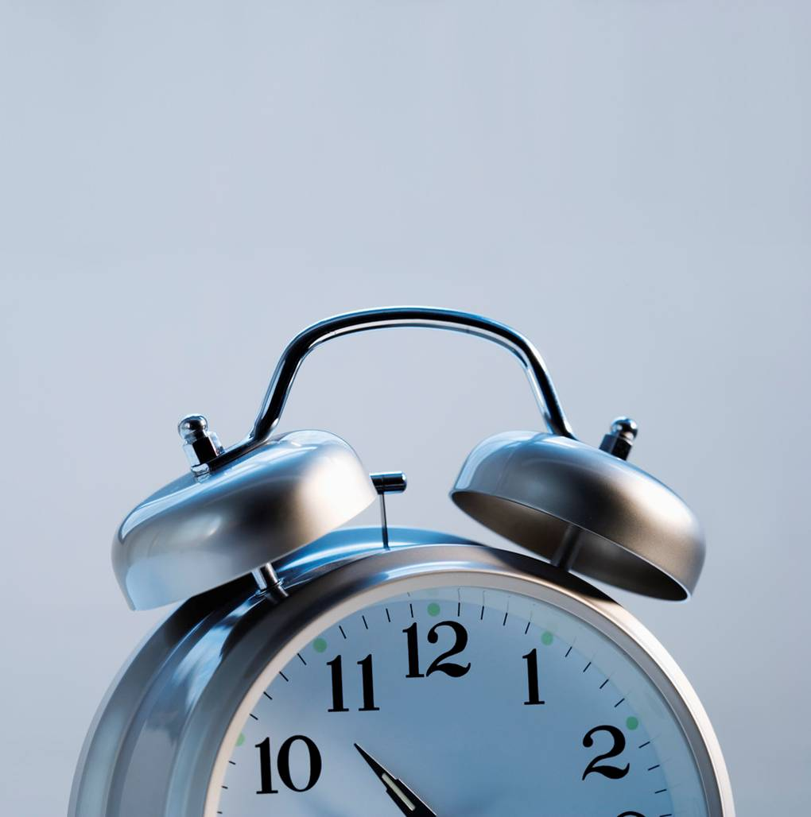
Elapsed Time

Slide 2
24
7
30
Date
Elapsed Time
EQ – How do we calculate elapsed time?
Summary:
5

Slide 3
Finding Elapsed Time
Given a starting time and an ending time, find out how much time was spent.
Given a start time and the amount of time spent, tell the finishing time.
Given an ending time and the amount of time spent, tell the starting time.

Slide 4
KEY POINTS TO REMEMBER:
You need to understand the difference between A.M. and P.M.
There are only 60 minutes in an hour. Therefore, using addition won’t always work, you have to think it through.

Slide 5
Midnight starts a new day
12:00 A.M. midnight is the beginning of each new day
You probably get up around 7:00 A.M.
10:30 or 11:00 A.M. you are thinking about lunch
12:00 P.M. IS NOON
After noon is PAST MORNING

Slide 6
Is it A.M. or P.M.?
P&C Meeting
PM
Getting Ready for School
AM
Getting Ready for Bed
PM

Slide 7
Is it A.M. or P.M.?
School Gets Out
PM
The Sun Rises
AM
Softball Game
PM
Stars In The Sky
PM

Slide 8
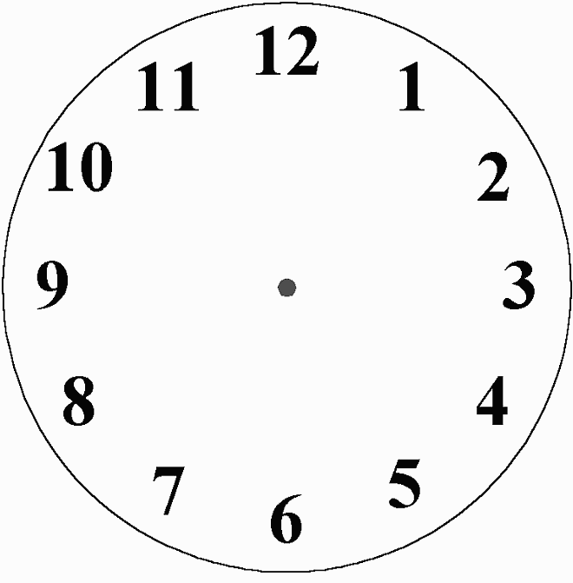
Each number on a clock represents 5 minutes.
Replacing the numbers with multiples of 5 will help you see why there are 60 minutes in an hour.

Slide 9
60
Each number on a clock represents 5 minutes.
Replacing the numbers with multiples of 5 will help you see why there are 60 minutes in an hour.
55
5
50
10
45
15
40
20
35
25
30

Slide 10
What time will it be 1 hour later?
3:17 PM
4:17 PM
11:53 PM
12:53 AM
7:43 PM
8:43 PM
2:51 PM
3:51 PM
EASY PATTERN

Slide 11
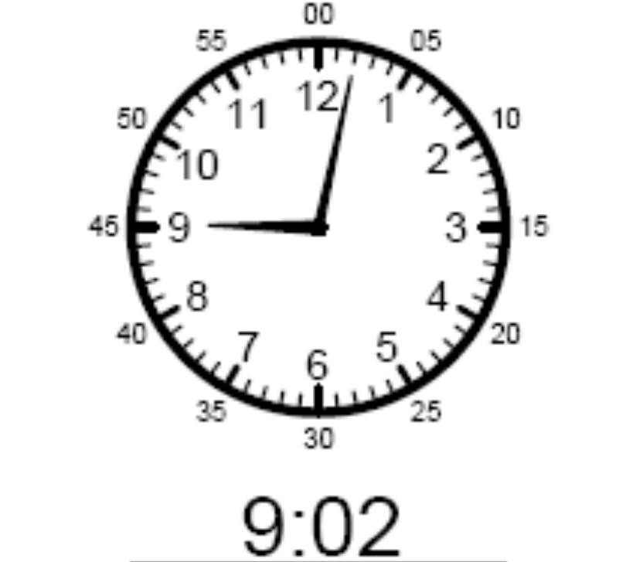
What time will it be15 minutes later?
If we add 15 minutes to the two minutes we have, the time will be 9:17

Slide 12
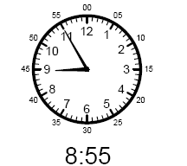
What time will it be15 minutes later?
If we add 15 minutes to the 55 minutes we have, the time will be 8:70
Only 60 minutes
in an hour
Simply adding will not work.

Slide 13
What time will it be15 minutes later?
In 5 minutes it will be 9:00.
We still have 10 more minutes
In 10 more minutes, it will be 9:10 or “ten minutes after 9”

Slide 14
What time will it be
15 minutes later?
3:17 PM
3:32 PM
11:53 PM
12: 08 AM
7:47 PM
8: 02 PM
2:51 PM
3:06 PM

Slide 15
Let’s Try Something More Challenging
What time will it be in
2 hours & 7 min.

Slide 16
What time will it be 2 hours & 7 minutes later?
What time will it be in 2 hours?
11:02
Now add 7 min.
That makes the time 11:09

Slide 17
What time will it be
2 hours and 7 minutes later?
3:17 PM
5:24 PM
10:51 AM
12:58 PM
7:43 AM
9:50 AM
2:51 PM
4:58 PM

Slide 18
Time Word Problems
Janice started reading a great book at 6:13pm. She finished at 9:28pm. How long did she spend reading?
HINT: Count up the hours and then the minutes.
7:13, 8:13, 9:13 = 3 hours
From 9:13 to 9:28 is 15 minutes

Slide 19
Time Word Problems
Brooke left home to visit her grandmother at 7:13 a.m. Her bike ride lasted 18 minutes. What time did she arrive?
HINT: If it had taken 20 minutes she would have arrived at 7:33, count back 2 minutes
After 10 minutes it is 7:23
After 10 more minutes it would be 7:33
Take two minutes away, and it is 7:31

Slide 20
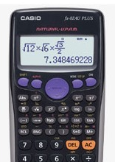
Adding and Subtracting Time using your calculator
Convert times to 24 hours first
Example 1 : What time will it be a 6 hours 20 minutes after 10:15 a.m.?
10:15 am = 1015
1015 + 0620 =
1
0
º ’ ”
1
5
º ’ ”
+
6
º ’ ”
2
0
º ’ ”
=

Slide 21
Time Word Problems
Students arrive at school at 8:30 a.m. They get back on the buses around 3:15p.m. How long is the school day?
Let’s take is step by step:
8:30 to 2:30 would be 6 hours.
Now add the 45 remaining minutes
The total is 6 hours and 45 minutes

Slide 22
Let’s Try This Problem Another Way
Students depart the buses at 8:30 a.m. They get back on the buses around 3:15p.m. How long is the school day?
You could also say from 8:30 – 3:30 is 7 hours.
Then subtract the minutes as you count back from 3:30 to 3:15. This will give you a total of 6 hours 45 minutes.

Slide 23
#1
Elapsed Time Practice
Jonas left home at 10:15 a.m. to head to the pool. He arrived at 10:37a.m.
How long was his ride?

Slide 24
#2
Elapsed Time Practice
At 4:33 Shelly left the grocery store. She spent 1 hour and 16 minutes shopping.
What time did she arrive at the store?

Slide 25
# 3
Elapsed Time Practice
Devin jogged with his dog from 1:14 p.m. to 3:03 p.m. He stopped for a 15 minute break. How long did he spend jogging?

Slide 26
#4
Elapsed Time Practice
Oprah and Gayle left Chicago at 8:00 a.m. and arrived in Cleveland at 11:43 a.m.
They stopped for lunch and were back on the road at 1:15 p.m.
They arrived in Erie, PA at 9:16 p.m.
How much time did they spend driving?
How long was their lunch break?

Slide 27
#5
Elapsed Time Practice
The ball decorating committee arrived at the high school at 4:30 to set up. The ball started at 7:30p.m. and ended at 1:00 a.m. The decorating committee left when the ball ended.
How much time did the committee members spend at the school on ball night?
What information in this problem is not needed?

Slide 28
Let's Check Our Answers
Created by Gwendolyn Best

Slide 29
#1
Elapsed Time Practice
Jonas left home at 10:15 a.m. to head to the pool. He arrived at 10:37a.m.
How long was his ride?
22 minutes

Slide 30
#2
Elapsed Time Practice
At 4:33 p.m. Shelly left the grocery store. She spent 1 hour and 16 minutes shopping.
What time did she arrive at the store?
Arrival Time 3:17p.m.

Slide 31
# 3
Elapsed Time Practice
Devin jogged with his dog from 1:14 p.m. to 3:03 p.m. He stopped for a 15 minute break. How long did he spend jogging?
1 hour 34 minutes

Slide 32
#4
Elapsed Time Practice
They drove 11 hrs 44 min
Oprah and Gayle left Chicago at 8:00 a.m. and arrived in Cleveland at 11:43 a.m.
They stopped for lunch and were back on the road at 1:15 p.m.
They arrived in Erie, PA at 9:16 p.m.
How much time did they spend driving?
How long was their lunch break?
Lunch lasted 1 hr 32 min

Slide 33
#5
Elapsed Time Practice
How much time did the committee members spend at the school on ball night?
What information in this problem is not needed?
8 hrs 30 min
8.5 hours
8 and a half hours
The prom started at 7:30p.m.

Slide 34
Plenary
With your partner, write in point form, how to calculate elapsed time.
Be prepared to share your answer.

